Slide 1
Module 4 Materialized View Processing and Design
Lesson 5: Oracle Tools for Data Integration
Notes:
Welcome to Lesson 5 of Module 4 on Materialized View Processing and Design
Opening question
Do you think that the ELT approach as exemplified by the Oracle Data Integrator will have a major impact on the data integration market in 10 years?
Possible but Oracle is not the leader in data integration now so ELT has an uphill battle

Slide 2
Lesson Objectives
Discuss major features of the Oracle Data Integrator
Provide scenarios for using the multiple table INSERT and MERGE statements
Explain examples of multiple table INSERT statements and MERGE statements
Notes:
Lesson 5 covers Oracle tools for data integration
Objectives:
List the major features of the Oracle Data Integrator
Explain the usefulness of the multiple table INSERT statement for data integration
Explain the usefulness of the MERGE statement for data integration
Explain SQL INSERT statements to insert into multiple tables
Explain SQL MERGE statements
Oracle Data Integrator
Recent tool developed as a result of Oracle’s acquisition of BEA Systems in 2007
Tight integration with Oracle database
Complex tool: only an overview is provided in these notes
SQL statements for data integration
Independent tools that are appropriate to smaller organizations without a need for an integrated, enterprise tool
MERGE statement: part of SQL standard
Multiple table INSERT statement: proprietary Oracle SQL statement
Assignment includes problems for the MERGE and multiple table INSERT statement

Slide 3
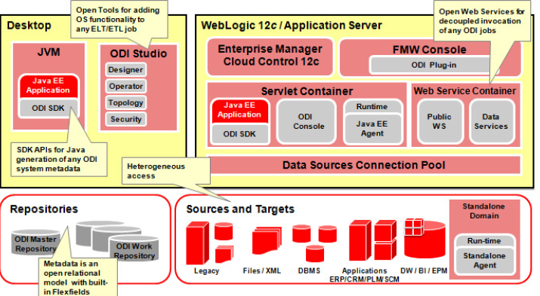
Oracle Data Integrator Components
Notes:
From: http://www.oracle.com/technetwork/middleware/data-integrator/overview/odi-12c-getting-started-guide-2032250.pdf (page 9)
ODI webcasts: http://www.oracle.com/technetwork/middleware/data-integrator/odi-11g-webcast-archive-367128.html
Distinctive features
ELT architecture that loads into Oracle tables
Perform transformations and integration after loading using Oracle DBMS engine
Declarative rules driven approach to separate specification from implementation
Platform independence although uses Oracle DBMS engine for transformations and integration
No separate ETL server
Operates with Oracle Fusion Middleware platform
ODI studio is the visible part of the Oracle Data Integrator
Designer
Operator
Topology
Security
ODI uses metadata repository
IT infrastructure
Meta data about all applications
Project scenarios
Execution logs
Supports transformation and integration from heterogeneous data sources

Slide 4
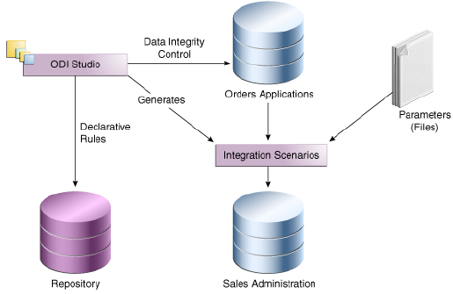
ODI Project Example
Notes:
From: http://www.oracle.com/technetwork/middleware/data-integrator/overview/odi-12c-getting-started-guide-2032250.pdf (page 30)
Sales administration is the target DW
Data sources
Orders application database
Parameter files with sales person and age group files
Integration scenarios
Execution plan with sequencing of components
Scenario includes all components (mappings, packages, procedures, variables)
Session is execution of a scenario

Slide 5
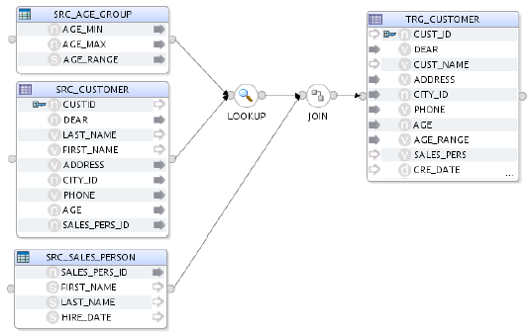
ODI Mapping Specification
Notes:
From: http://www.oracle.com/technetwork/middleware/data-integrator/overview/odi-12c-getting-started-guide-2032250.pdf (page 31)
Mapping
Source table
Target table
Lookup table for transformations and filters
Join to combine data sources in the target
Target expressions for transformations in the target data source
Target expressions:
Column name changes (CustId to Cust_Id)
Concatenation of customer first and last name into name
Convert numeric marital status to abbreviation (Mr., Ms., Mrs.)
Convert age to age range
Concatenation of sales person first and last name into sales person name
Lookup table is associated to a data source.
Lookup operation assures that customer age is within minimum and maximum ages
Join with sales person table

Slide 6
MERGE Statement
Useful in data integration processes
Conditionally update or insert rows using a single SQL statement
Insert if no match
Update if match
Improved productivity and performance
Part of SQL standard since SQL:2003
Notes:
Useful for dimension table changes
New rows
Changes to existing rows
Advantages:
Avoids multiple statements (INSERT and UPDATE)
May need to write custom code for update processing
May need to use separate source files

Slide 7
MERGE Statement Structure
Source Table
Target Table
(after Merge)
MERGE INTO <Target_Table>
USING <Source_Table>
ON <join_condition>
WHEN MATCHED THEN
UPDATE SET …
WHEN NOT MATCHED THEN
INSERT …
Target Table
Notes:
Legend:
Red: updated rows
Light blue: new rows
Yellow: existing rows in the target table
Dark blue: column names
Target table may have rows not in the source table
Source table contains new and updated rows
Source table contains changes and new rows
Target table (usually a dimension table) should be merged with the source table.
Revised target table contains result of merge

Slide 8
MERGE Statement Example
SSCustomer
(after Merge)
SSCustomerChanges
MERGE INTO SSCustomer Target
USING SSCustomerChanges Source
ON (Target.CustId = Source.CustId)
WHEN MATCHED THEN
UPDATE SET
Target.CustName = Source.CustName,
…
Target.CustNation = Source.CustNation
WHEN NOT MATCHED THEN
INSERT (Target.CustId, … )
VALUES (Source.CustId, … );
SSCustomer
Notes:
Legend:
Red: updated rows
Light blue: new rows
Yellow: existing rows in the target table
Dark blue: column names
Target table may have rows not in the source table
Source table contains new and updated rows
SSCustomerChanges table has same column structure as SSCustomer (dimension table)
Changed rows with all column values including changed values
New rows with all column values
Change data capture must have created CustomerChanges table.
Full statement: see Unit 6 Part 3 examples document
MERGE INTO SSCustomer Target
USING SSCustomerChanges Source
ON (Target.CustId = Source.CustId)
WHEN MATCHED THEN
UPDATE SET
Target.CustName = Source.CustName,
Target.CustPhone = Source.CustPhone,
Target.CustStreet = Source.CustStreet,
Target.CustCity = Source.CustCity,
Target.CustState = Source.CustState,
Target.CustZip = Source.CustZip,
Target.CustNation = Source.CustNation
WHEN NOT MATCHED THEN
INSERT (Target.CustId, Target.CustName, Target.CustPhone,
Target.CustStreet, Target.CustCity, Target.CustState,
Target.CustZip, Target.CustNation)
VALUES (Source.CustId, Source.CustName, Source.CustPhone,
Source.CustStreet, Source.CustCity, Source.CustState,
Source.CustZip, Source.CustNation);
Statement parts
Target table specification
Join condition
Matched clause with UPDATE statement (all columns)
Not matched clause with INSERT statement
Variation for when change table rows only have changed values
WHEN MATCHED UPDATE SET
Target.CustName = DECODE(Source.CustName, NULL, Target.CustName, Source.CustName),
Target.CustPhone = DECODE(Source.CustPhone, NULL, Target.CustPhone, Source.CustPhone),
Target.CustStreet = DECODE(Source.CustStreet, NULL, Target.CustStreet, Source.CustStreet),
Target.CustCity = DECODE(Source.CustCity, NULL, Target.CustCity, Source.CustCity),
Target.CustState = DECODE(Source.CustState, NULL, Target.CustState, Source.CustState),
Target.CustZip = DECODE(Source.CustZip, NULL, Target.CustZip, Source.CustZip),
Target.CustNation = DECODE(Source.CustNation, NULL, Target.CustNation, Source.CustNation)

Slide 9
Multiple Table INSERT Statement
Useful in data integration processes
Partitioning
Unconditional for partitioning by columns
Conditional for partitioning by rows
Improved performance and productivity
Oracle proprietary extension
Notes:
Multitable INSERT statements can be used in data integration tasks to transfer data from one or more operational sources to a set of target tables
Provide significant performance improvement over: – Single DML versus multiple INSERT...SELECT statements – Single DML versus a procedure to do multiple inserts using IF...THEN syntax
Data warehouse applications
Insert into fact tables
Partitioned fact tables by time (such as quarter) or dimension attributes such as product type

Slide 10
Multiple Table INSERT Structure
Target Table 1
INSERT [ ALL | FIRST ]
[WHEN <condition> THEN]
INTO <Target_Table1> …
[WHEN <condition> THEN]
INTO <Target_Table2> …
[ELSE]
INTO <Target_TableN> …
SELECT … FROM <Source_Table>;
SourceTable
Target Table 2
Notes:
Legend:
Dark blue: column names (row heading)
Yellow rows for target table 1
Red rows for target table 2
Light blue rows: existing rows
ALL versus FIRST
ALL will insert into all tables
FIRST will insert only into first table with WHEN condition
ALL can be used with WHEN conditions but each condition is tested. ALL is assumed if WHEN conditions.
Typically ALL is used without WHEN conditions (unconditional) and FIRST is used with conditions (conditional)
INSERT FIRST and INSERT ALL are equivalent when conditions are mutually exclusive.
Unconditional versus conditional insert
- INSERT ALL
WHEN conditions are optional
- Conditional insert

Slide 11
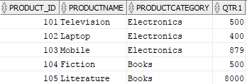
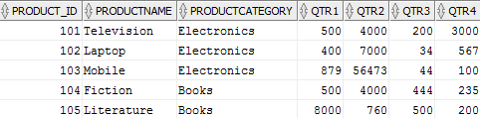
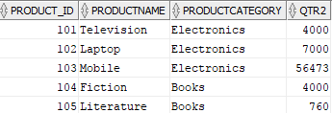
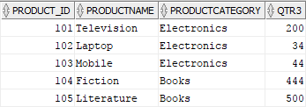
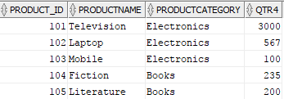
Unconditional INSERT ALL Example
ProductSale
Qtr1Sale
Qtr2Sale
Qtr3Sale
INSERT ALL
INTO QTR1Sale VALUES (Product_ID,ProductName,ProductCategory,Qtr1 )
INTO QTR2Sale VALUES (Product_ID,ProductName,ProductCategory,Qtr2 )
INTO QTR3Sale VALUES (Product_ID,ProductName,ProductCategory,Qtr3 )
INTO QTR4Sale VALUES (Product_ID,ProductName,ProductCategory,Qtr4 )
SELECT * FROM PRODUCTSALE;
Qtr4Sale
Notes:
Insert into vertical partitions with different quarter sales column in each table
SELECT statement is part of INSERT statement
Provides source of rows
Semicolon terminates entire statement including SELECT clause

Slide 12

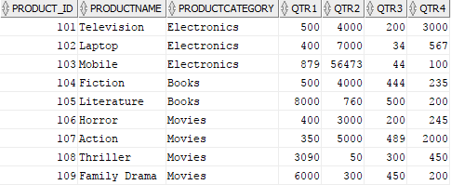


Conditional INSERT FIRST Example
ElectronicsSale
ProductSale
BooksSale
MoviesSale
INSERT FIRST
WHEN (ProductCategory = 'Electronics') THEN
INTO ElectronicsSale VALUES (Product_ID,ProductName,ProductCategory,(Qtr1+Qtr2+Qtr3+Qtr4))
WHEN (ProductCategory = 'Movies') THEN
INTO MoviesSale VALUES (Product_ID,ProductName,ProductCategory,(Qtr1+Qtr2+Qtr3+Qtr4))
WHEN (ProductCategory = 'Books') THEN
INTO BooksSale VALUES (Product_ID,ProductName,ProductCategory,(Qtr1+Qtr2+Qtr3+Qtr4))
SELECT * FROM PRODUCTSALE;
Notes:
Insert into horizontal partitions according to product category
Divide source table into tables for each product.
Use WHEN conditions to check for product category values
Aggregate quarter sales into total sales
SELECT statement is part of INSERT statement
Provides source of rows
Semicolon terminates entire statement including SELECT clause

Slide 13
Summary
ELT architecture with optimization advantages
Comprehensive tool for data integration
SQL standard MERGE statement
Oracle proprietary multiple table INSERT statement
Notes:
Oracle has made major investments for summary data storage and data integration.
Oracle Data Integrator
Comprehensive tools although a long path towards comprehensive product offerings
Oracle has a burden of a legacy of data integration tools.
Primary advantage of Oracle Data Integrator tool is optimization opportunities as its ELT approach can fully utilize Oracle’s optimizing database compiler and parallel processing technologies.
Multiple table INSERT statement (proprietary) and MERGE statement (SQL standard) are useful in data integration tasks.
Assignment covers INSERT and MERGE statements

